Slide 1
DreamScape: A Multi-Effect Guitar Sequencer
Team: sddec18-21
Calyn Gimse, Derrick Lawrence, Tyler McAnally, Charles Rigsby, Karla Beas

Slide 2
Problem Statement
Effect Pedals play an important role in live performances.
Multiple effects require stringing multiple pedals with each other and become complex and messy
Effects in parallel not easily possible with standard effect pedals
Configuration of configurable boards on market unintuitive
Many still only accept one effect at a time or only effects in series
Configuration of presets only allow one on the board at a time
Our plan is to design a pedal-board that allows free configuration of effects
Intuitive UI
Multiple presets loaded to free-switch in the middle of a set
Efficient signal processing
Modular preset design to allow for additional effects to be added in the future

Slide 3
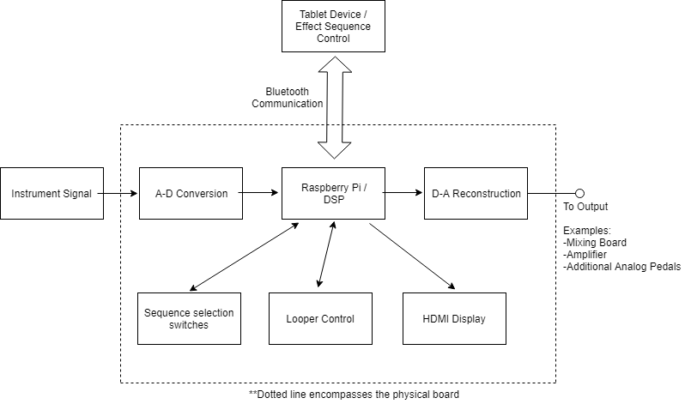
Our Solution
Raspberry Pi microcontroller used to process signals
ADC/DAC circuit used to send signals to/from the Pi
Android Application used to configure presets with the board
Display on board used to show current selected preset
Board takes input from a guitar, output to an amplifier
Input stage can accept a signal from any source with an amplitude between 50 mVpp and 4.5 Vpp

Slide 4
Project Design-Software
Signal Processing code written in C
Bluetooth Socket methods written in Python
Reads preset files to set proper effect configuration
Takes in an input signal from ADC input
Outputs the processed signal to DAC output
Individual effects are separate methods that modify the signal
Some effects were referenced from PedalPi, an Open Source lo-fi single-effect pedalboard.
Most effects were edited for our purposes
Some effects (such as loopers) are 100% original.
Early testing of effects used with wavefiles outputted through auxillary output using PortAudio Open Source Library.
X11 Libarary used to display simplistic UI on the board.

Slide 5
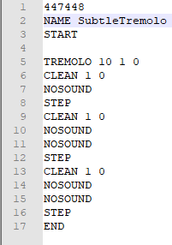
Project Design-Software
Preset Format:
Verification string (447448)
Preset name prefixed with NAME
START starts input, END signals end of preset
STEP signals moving to the next layer
Effect:
Name
Effect-specific Vals (optional)
Options bit (optional, usage varies)
Effect Weight (not on NOSOUND)
Which layer to get sound from (0=default)

Slide 6
Project Design-Software
List of Effects:
Clean:Output unaltered sound
Bitcrush: Shift sound left by n bits
Booster: Boost audio by a fractional value
Delay: Adds a delay to outputted sound
Distortion: Cap highest and lowest possible sound
Echo: Plays a delayed sound that tapers off
Fuzz: Sets signal above/below a threshold to max/0
Tremolo: Compares amplitude with a waveform to change audio volume in a sine wave
NoSound: Output nothing.
Octaver: Shifts pitch of audio by changing the speed at which the sound outputs, can also be a looper
Loopers: See Next Slide

Slide 7
Project Design-Software
Looper Effects
Accidental novel discovery
Records an audio signal, and repeats the signal on an infinite loop
Options to wipe audio or record over recorded audio
Recorded audio can be outputted many ways:
Standard (Looper)
Reverse (InvertLooper)
Forward/Backward (or vice-versa)
At a different pitch/speed (Octaver)
Looper buffer can be statically set, or dynamically set when recorded (to a certain limit)

Slide 8
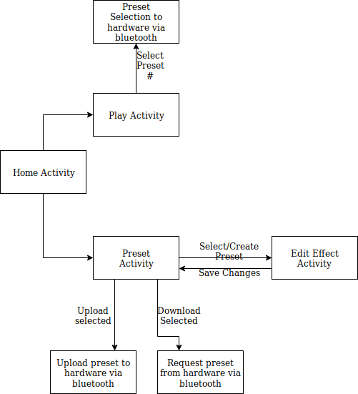
Project Design-Application
Application developed in Android
Communicates with Software via Bluetooth socket
Sends/receives commands and preset files
Can send commands to change presets in software
Deprecated by footpedals but still implemented
Configures and saves presets internally

Slide 9
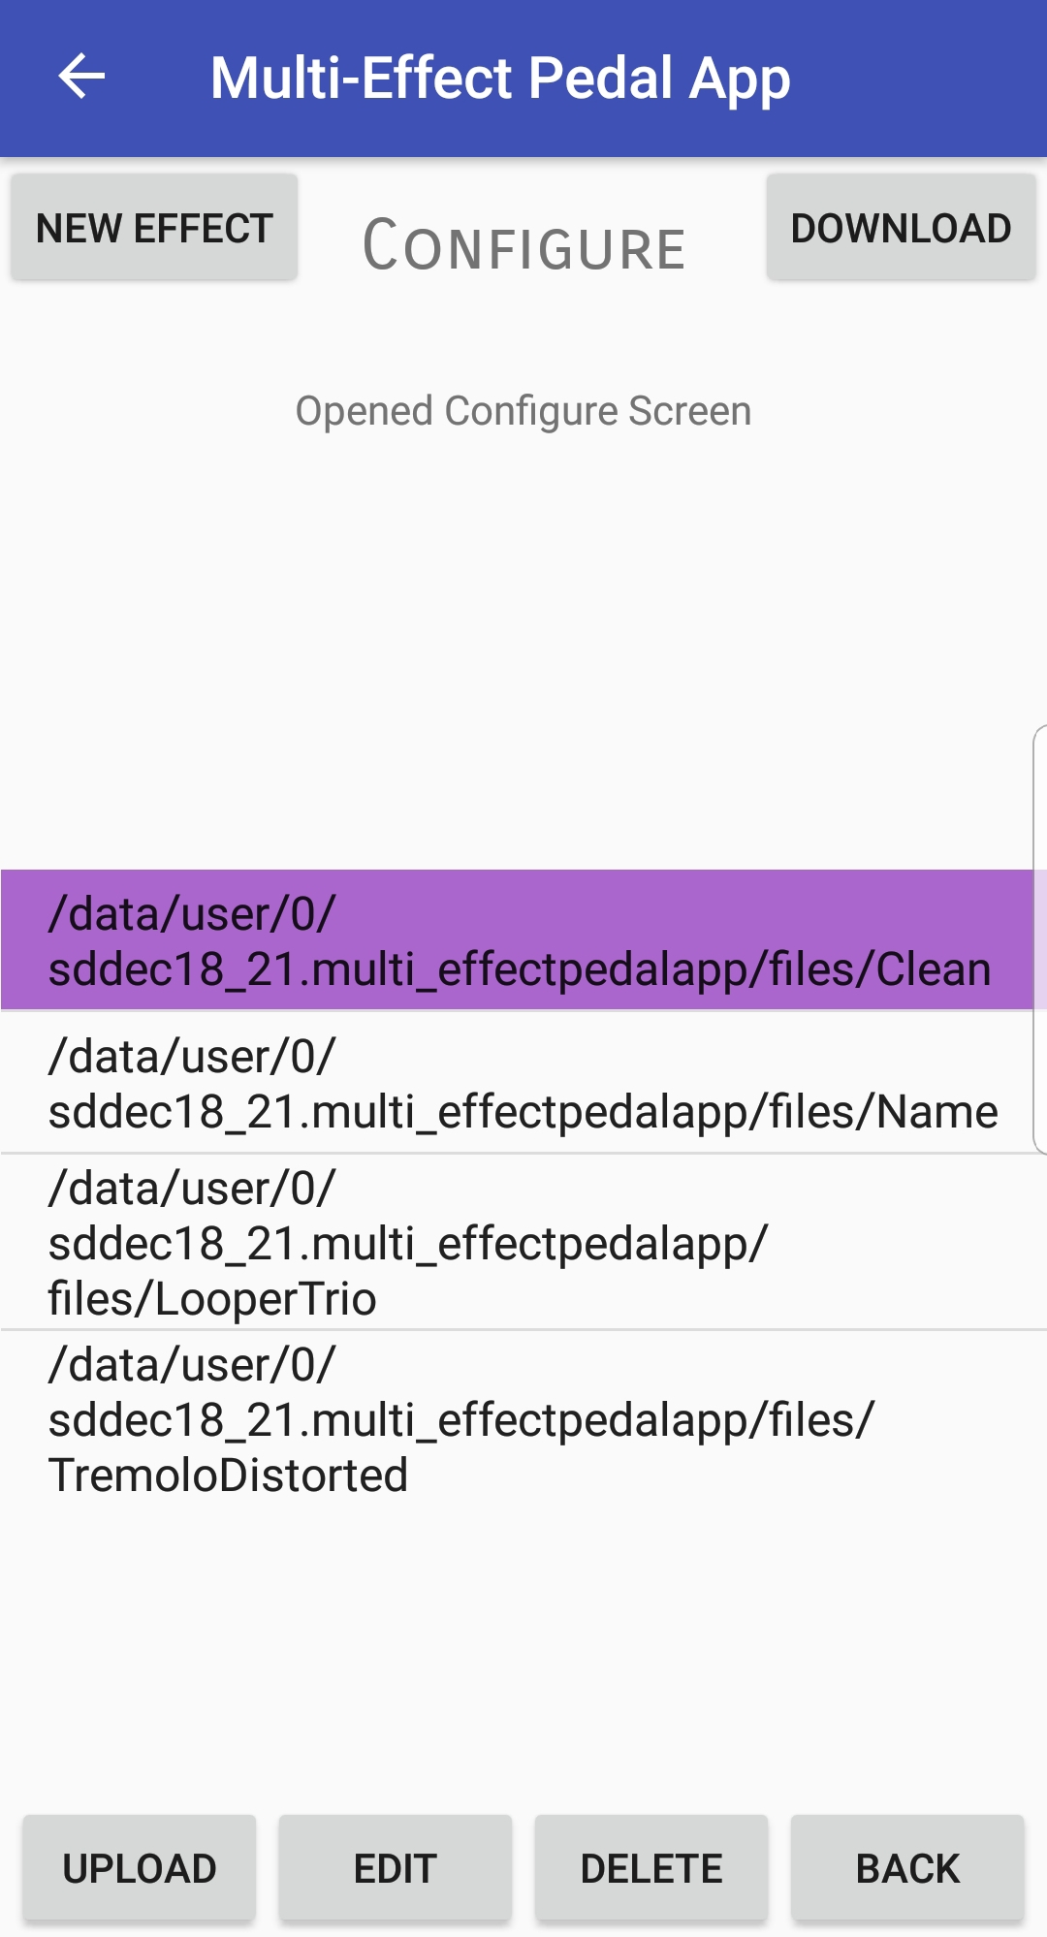
Project Design-Application
Preset Configuration Activity:
Shows a list of presets stored on the device
Can download presets from the board and add to the list
Can upload presets onto the board
Can create new(blank) presets
Can edit presets

Slide 10
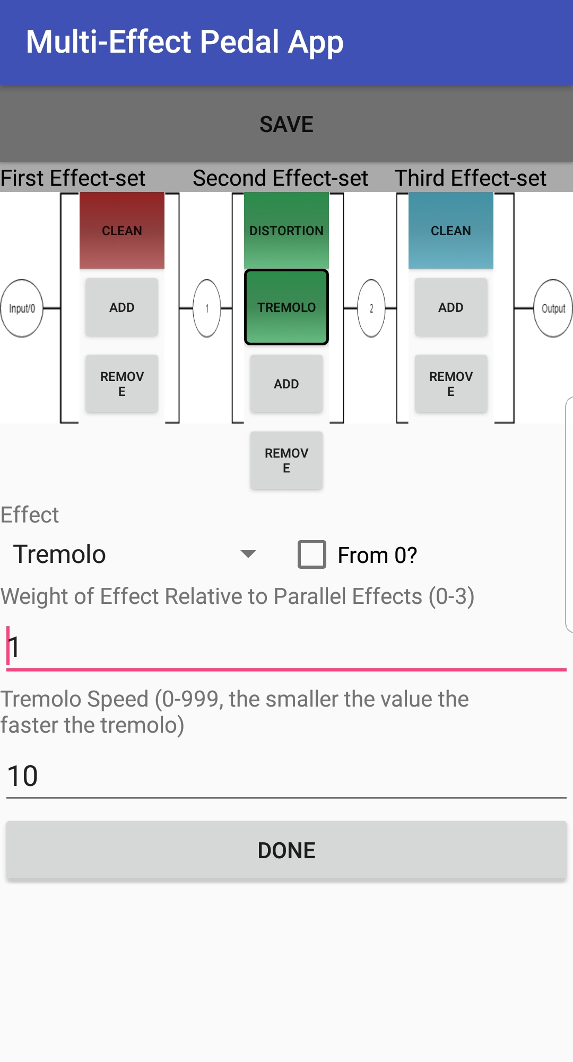
Project Design-Application
Preset edit activity:
Shows a simplistic diagram of the effect mux
More/Less effects can be added in parallel
Preset file stores unused spots as NOSOUND effects
Tapping a preset opens a configuration box
Fields are unique to each effect

Slide 11
Project Design-Hardware
IC overview:
ADC used to convert guitar signal to binary data for DSP stage
DAC advantageous over PWM for D-to-A reconstruction
Dual package Op-Amp used for input and output stage
Chips used were specced with a Vdd supplied by Pi3 +5V rail

Slide 12
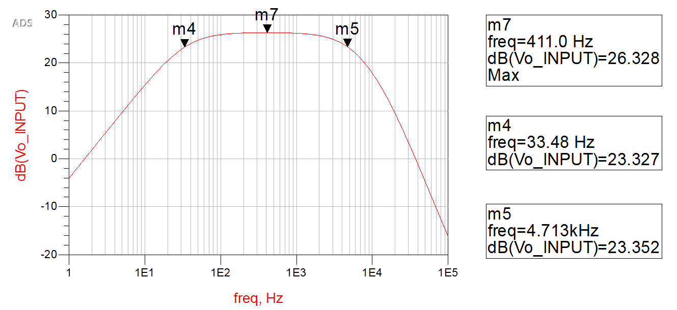
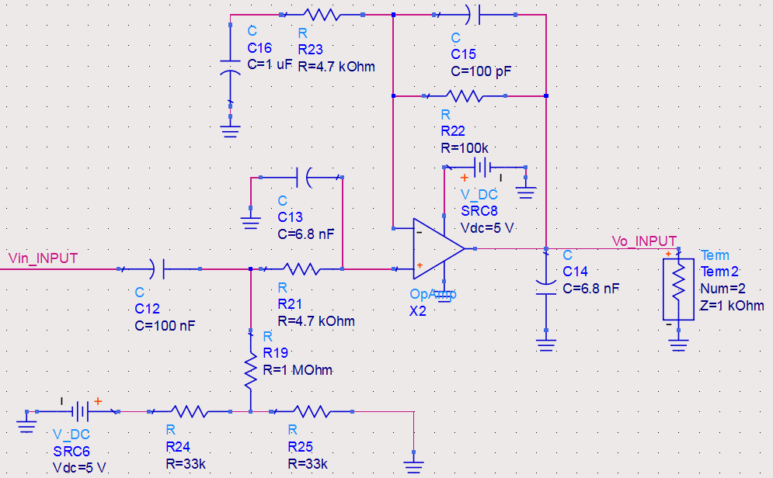
Project Design-Hardware
Input Stage:
4th order band-pass filter to remove noise and high order harmonics
Bias network to prevent negative voltage input to ADC
Op-Amp provides low impedance source per ADC datasheet
Active pickups require removal of top panel

Slide 13
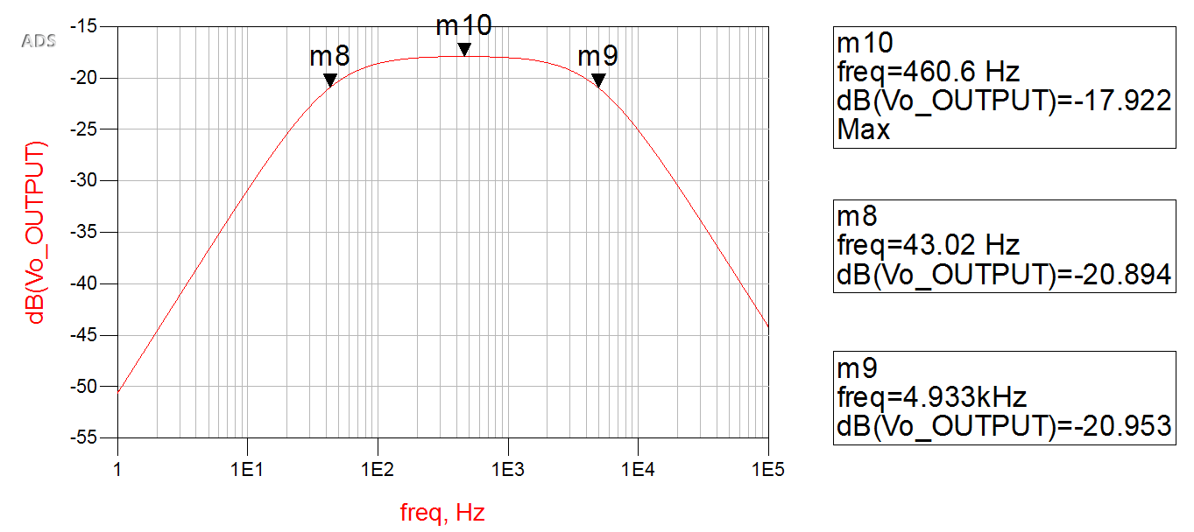
Project Design-Hardware
Output stage:
2nd order band-pass filter
Unity buffer to provide low output impedance
DC blocking capacitor to remove the bias of the DAC output.

Slide 14
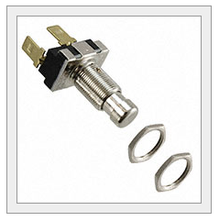
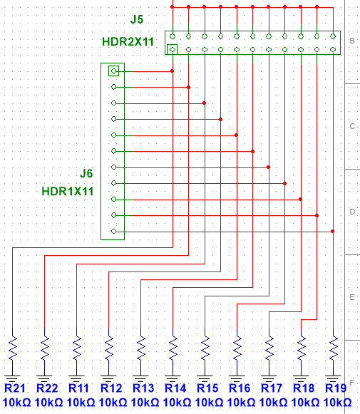
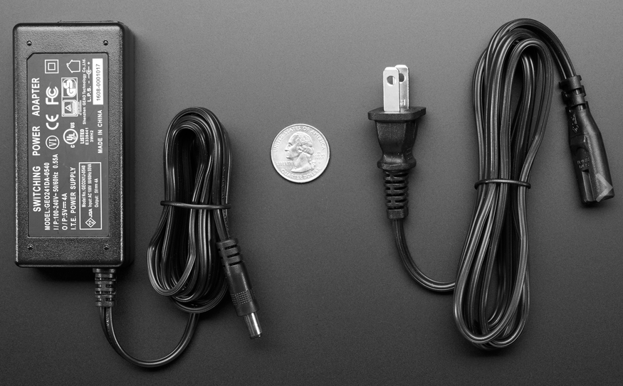
Project Design-Hardware
Switching and Display:
Rugged, momentary contact push-button switches used for switching
+3.3V Pi3 rail, along with 10k series resistor keep current draw low
+5V, 4A power supply with Micro-usb splitter to power Pi and HDMI display
Pi3 suggested current rating of 2.5A max and display requires 600mA
Display panel large enough to see across stage by performer

Slide 15
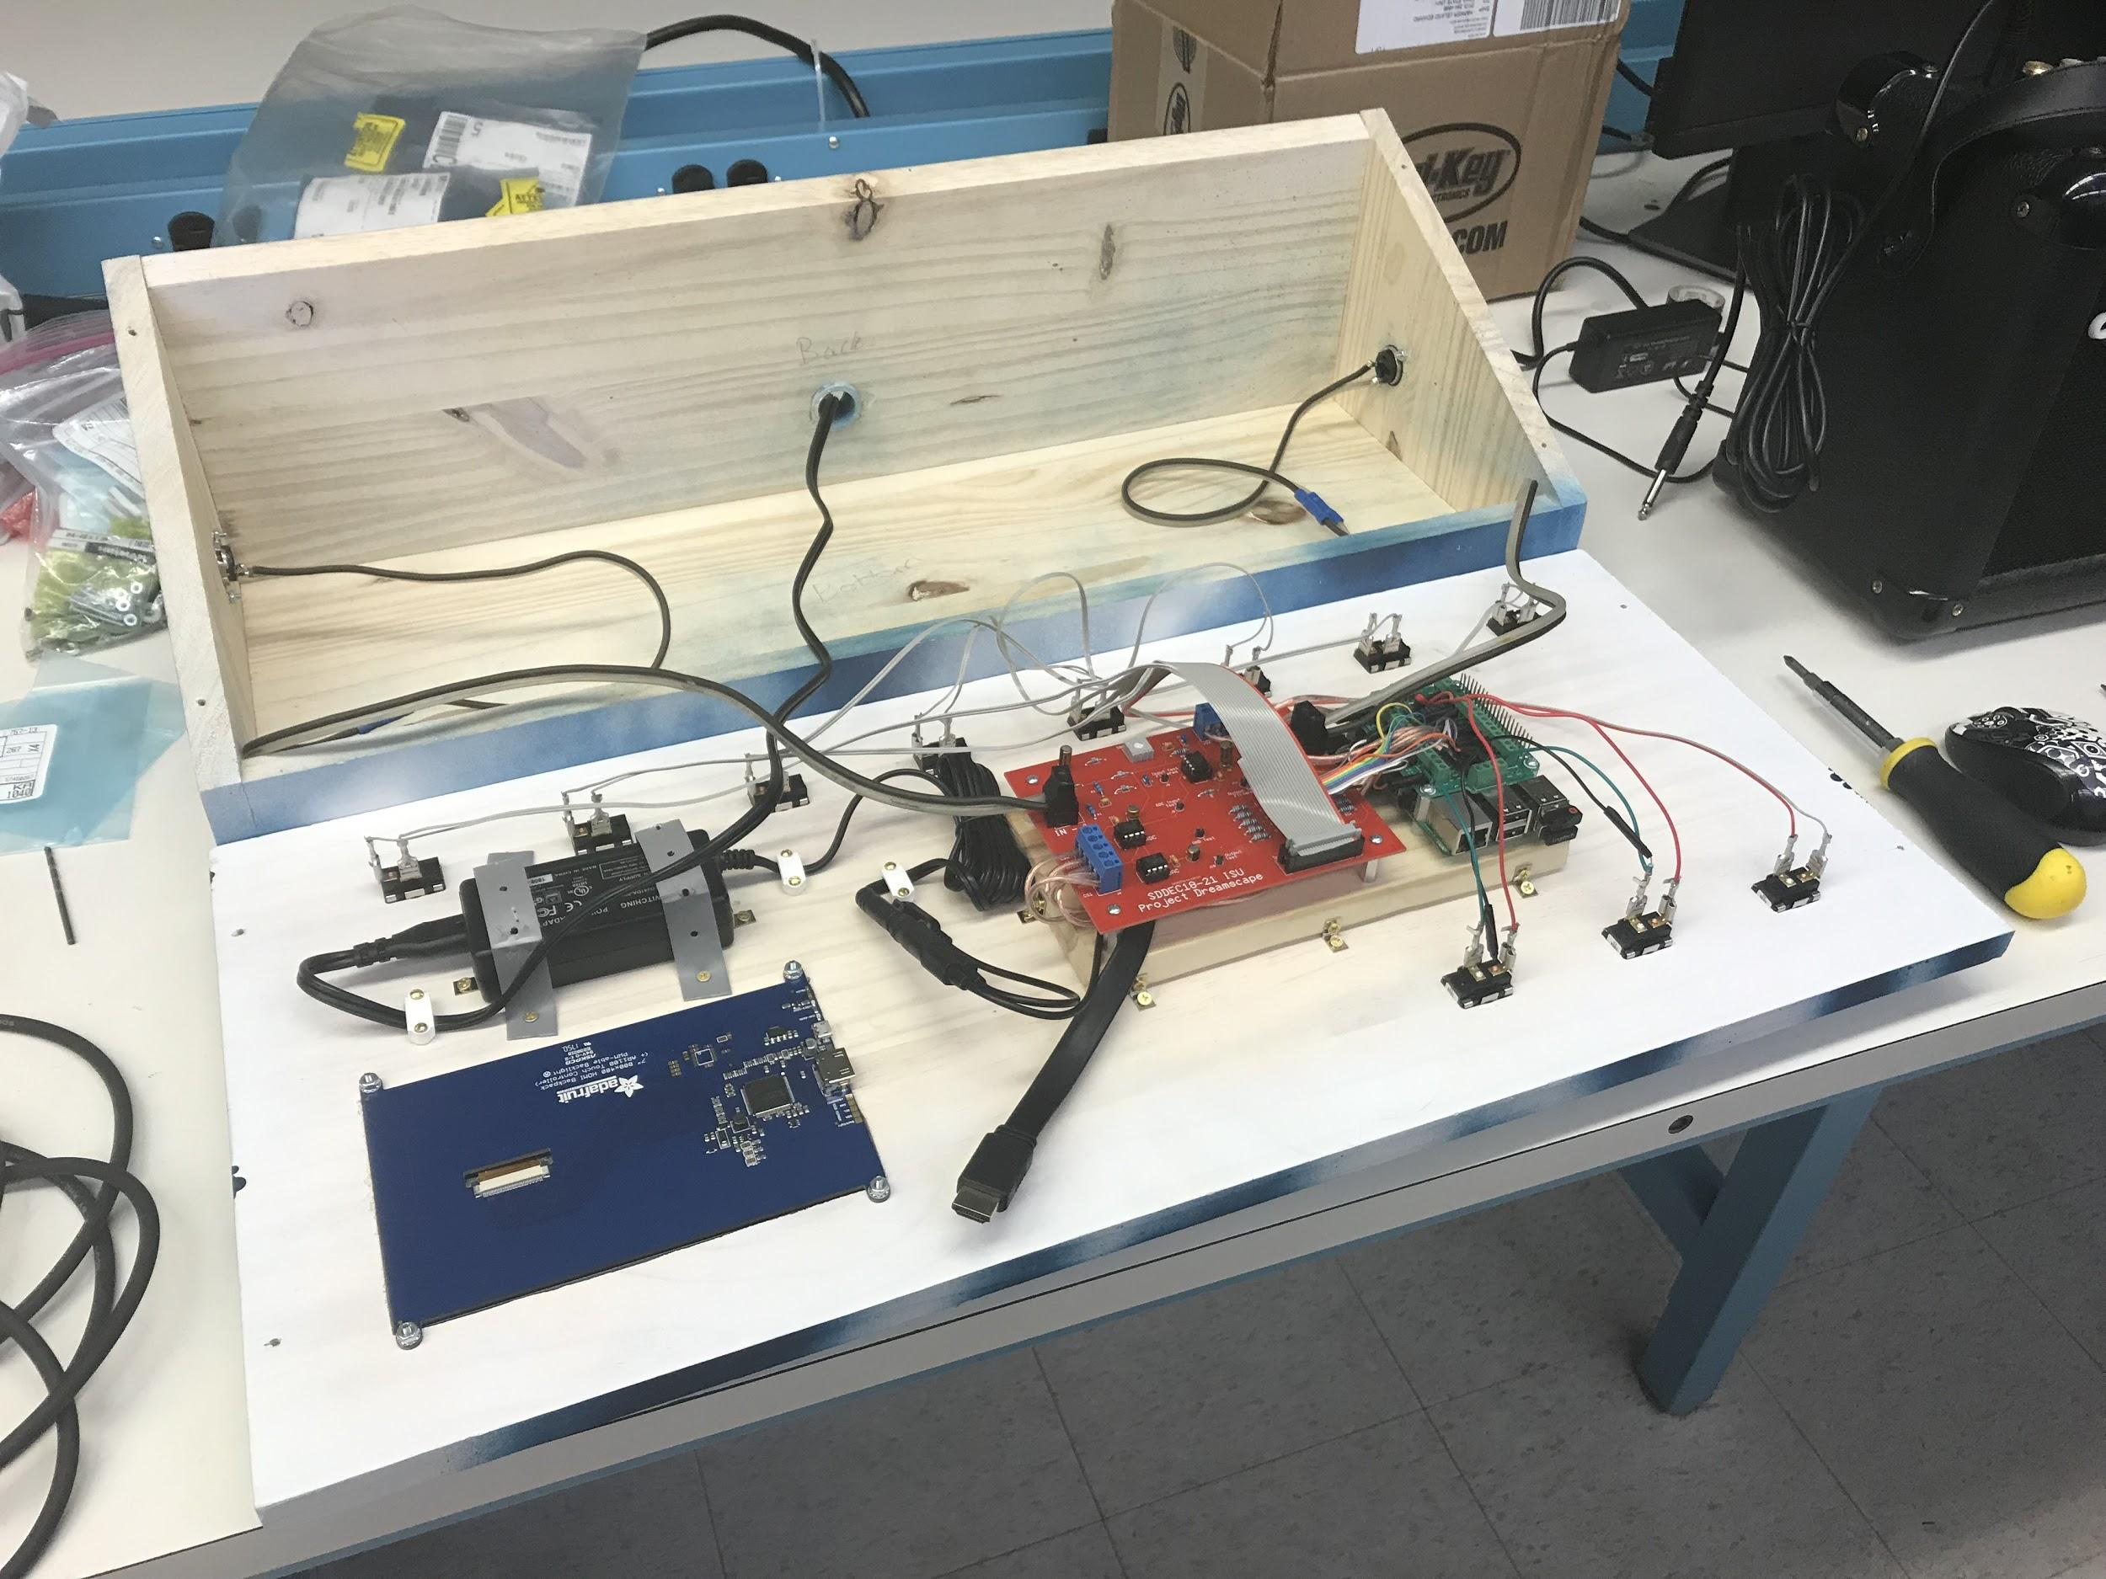
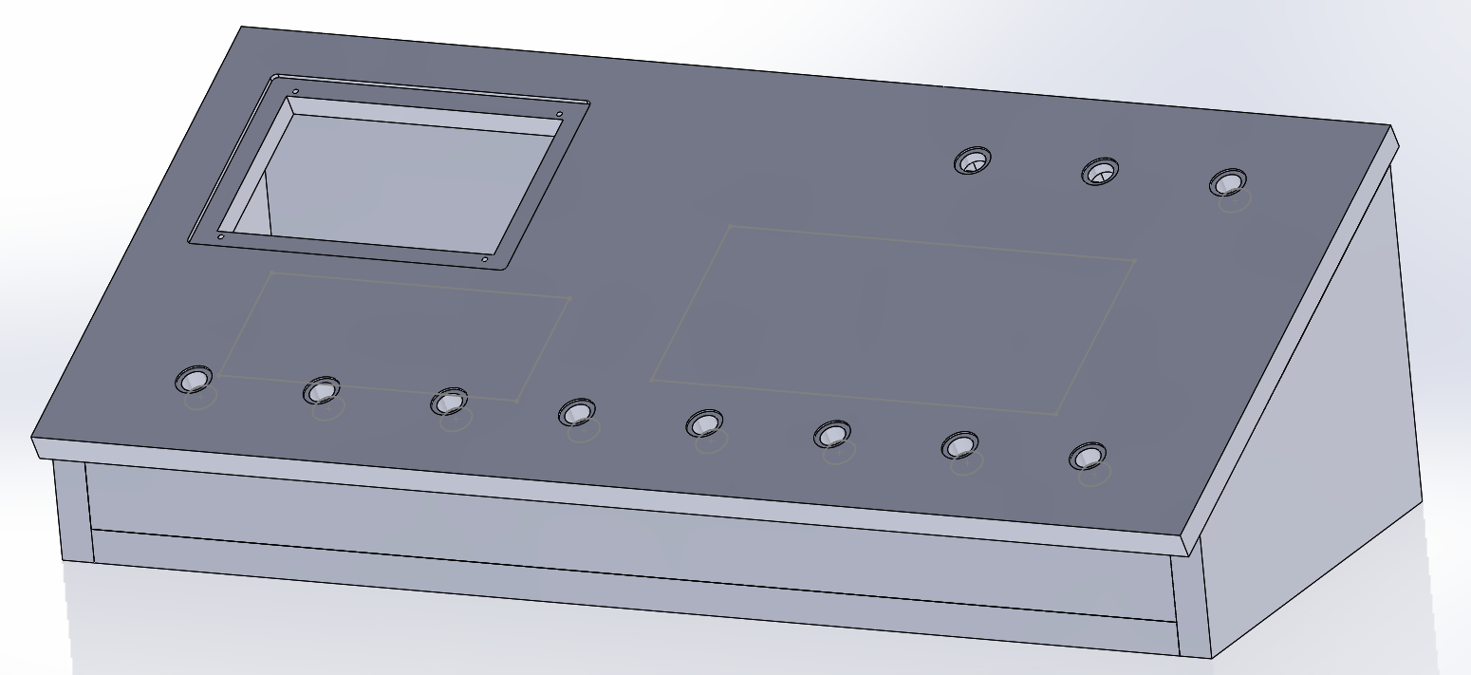
Project Design-Enclosure
Solidworks used to model the enclosure and DXF export for CNC milling
Made of wood with plexi-glass display cover
Cheap, durable, and easily workable - weather resistant with attentive care
Hardware mounted to underside of top panel for easy removal

Slide 16
Project Cost Analysis
Enclosure:
Wood - $20
Screws - $10
Brackets & Standoffs - $10
Plexiglass - $5
Paint - $15
Other - $10
Tablet - $60
Raspberry Pi3 - $35
Terminal Block Pi Shield - $20
HDMI Display - $80
Foot Switches - $60
Power Supply - $20
Interconnects - $30
IC Chips - $10
Passive Components - $20
Prototyping + Leftover - $150
Total Project Cost = $555

Slide 17
Demo
Questions?

